Slide 1
Final Project
Quick & Draw

Slide 2
Quick, Draw
https://quickdraw.withgoogle.com/
AI can draw doodle
Classification
Generation
Dataset
contains 50M drawings encompassing 340 label categories

Slide 3
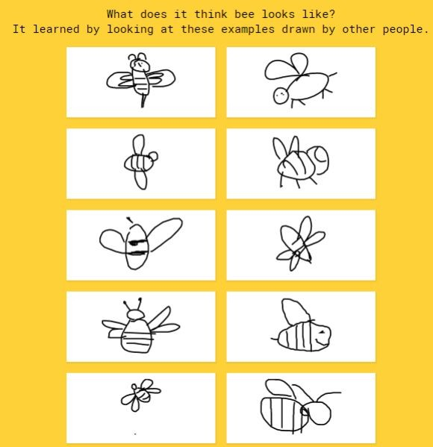
You need to do
Train a doodle AI
Basic
Classiﬁer (Guess)
Given a doodle draw, classify what the image it is
Advanced
Generator (Draw)
Given the topic, automatically generate ten images

Slide 4
Database
TAs provide simpliﬁed dataset
30 label categories
Avoid some problems during training models
Link
https://drive.google.com/drive/u/0/folders/1oXL8hEyekOARy3X0-1wJKz2Xxn_9syZu?fbclid=IwAR1mkkwTXJ_0fokysyGMAJ0tFqY_bAAkhRVZUt6Zz2o4iuHMwUJNqr_8dOE

Slide 5
Evaluation
30% Classiﬁer
30 Questions
30% Generator
10 Questions
TAs will use our classiﬁer to judge
Demo on 1/8 on class
20% Presentation
Presentation 1/13
20% Report

Slide 6
Classiﬁer
Input
csv
Another 200 unlabeled test data would be provided for the evaluation.
Output
csv
An output data with one predict label in the same order of the testing.csv.
Report.
You are also encouraged to implement data argumentation by your generating data.

Slide 7
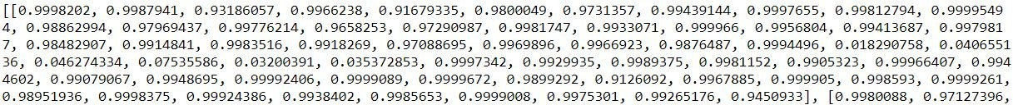
Generator
Input
csv
30 categories of the training data that used in classiﬁer.
Output
png
10 images for 1 category
Each image is 64x64
Save path is /output/image, and ﬁle name format is name_id.png.
Ex: /output/image/bee_1.png
csv
Content is like this:
1 csv for 1 image
Save path is /output/csv, and ﬁle name fomat is name_id.csv.
Ex: /output/csv/bee_1.csv

Slide 8
Generator
Report
You are encouraged to use any type of Generative Adversarial Network(GAN) to generate images.

Slide 9
Demo
Hold on 1/8 10:00 ~ 11:00
Each team makes sure to bring your own laptop
TAs will announce questions on iLMS
After running your model, submit your result on the iLMS before 11:00

Slide 10
Presentation
1/13 10:00 ~ 12:00
Each team should make a video less than 4 minutes to present your work and upload it before 1/12 11:59. We will play these on class and there will be a brief QA.
Make sure your content include
Methodology
Evaluation
Test Result
Demo Result
Discussion
Conclusion

Slide 11
Report
Methodology
Classiﬁer
Generator
How to train your model
Parameter Setting
Optimizer
Evaluation
etc
Test Result
Demo Result
Discussion
Conclusion
Less than 3 pages to summarize your project

Slide 12
Submission Deadline
1/7 23:59 submit your code
Python code (.py)
1/8 10:00 ~ 11:00 submit your result of demo
Classiﬁer result (.csv)
Generation result (.png and .csv)
1/12 11:59 submit your presentation ppt slides 、report 、video
PPT slides (.pdf)
Report (.pdf)
Video(.mp4)

Slide 13
TA Ofﬁce Hour
EECS Building R830
Time
Thursday 1300-1500
Please send your arrival time and questions by email in advance.
We also encourage you to Google your questions before you come.

